Slide 1

THE CHAT-BOT
Sri Sai Valli
Mudit Garg
Parth Rai
Rachit Chauhan

Slide 2
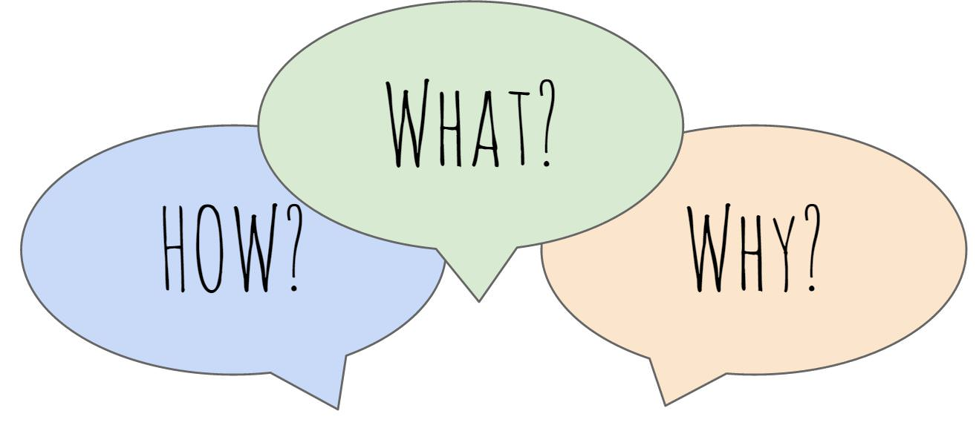

Slide 3
What Is A Chat -Bot?
Chatbot or bot – is a computer program that simulates a natural human conversation.
A chatbot is a piece of software that conducts a conversation via auditory or textual methods.
Chatbots interpret and process user's words or phrases and give an instant pre-set answer.

Slide 4
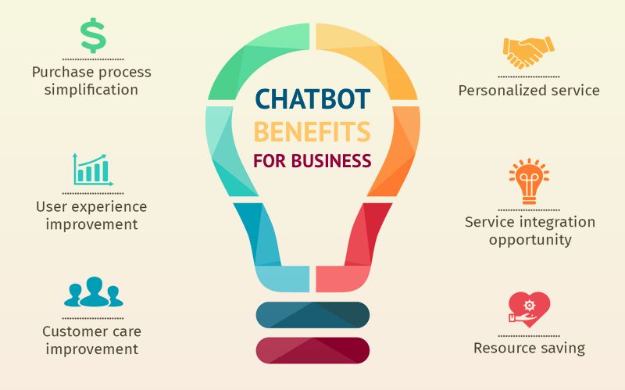
Why CHAT-BOT?

Slide 5
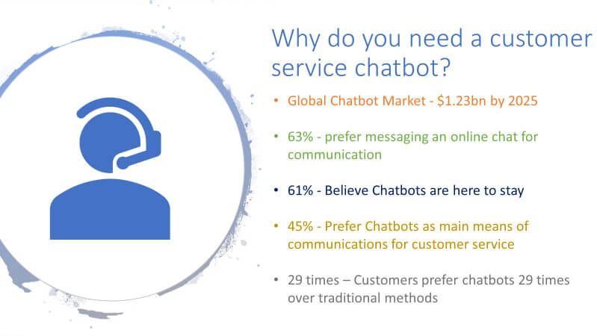
Why Chat-Bot???

Slide 6
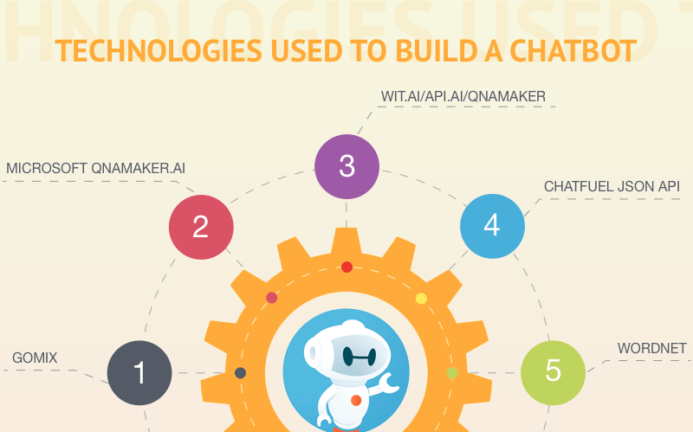
How it can be Designed??

Slide 7
How it can be Designed??
There are many ways to create a chat-bot.
We are using Java to create a chatbot , with the help of AIML.
AIML, or Artificial Intelligence Markup Language, is an XML dialect for creating natural language software agents.
AIML makes it possible to create human interfaces while keeping the implementation simple to program, easy to understand and highly maintainable.

Slide 8
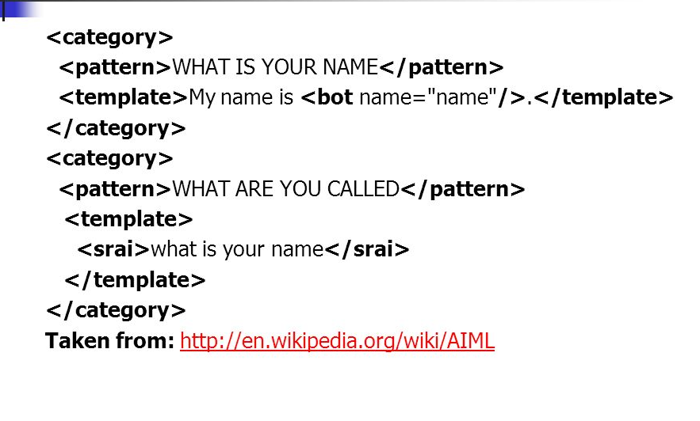
AIML Example -

Slide 9
Implementation in Eclipse
Create eclipse project
Create maven project and import AIML library
Add AIML to classpath
Create your own chatbot program

Slide 10
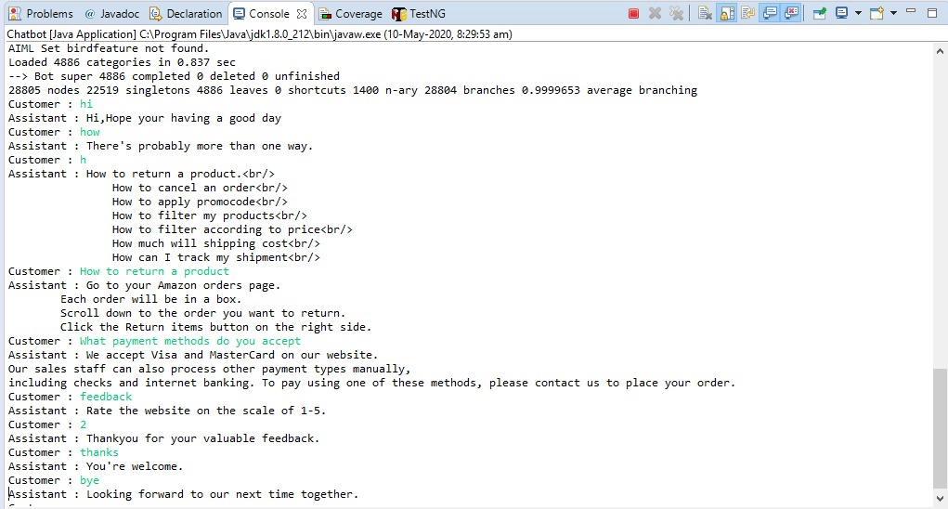
OUTPUT

Slide 11
Pandora Bots
It is an artificial intelligence company that runs a web service for building and deploying chat bots.
It a platform where we can build and deploy our chatbot. It is based on “aiml”, we build the code in “aiml” and the output is provided with proper framework/outline for our coded chatbot.
Common use cases includes advertising, virtual assistance, e-learning, entertainment and education.

Slide 12
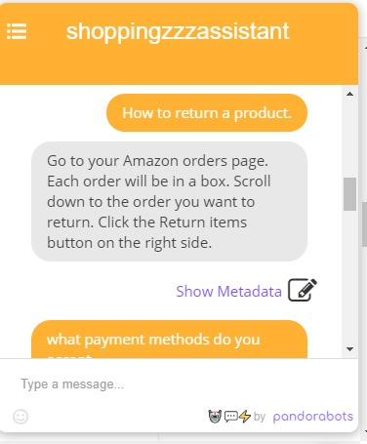
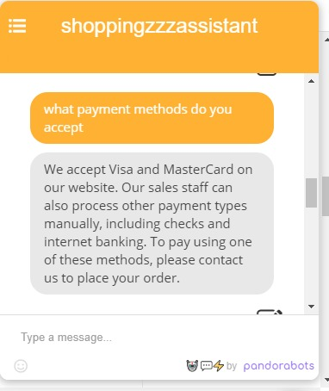

Slide 13
THANK YOU

